Slide 1
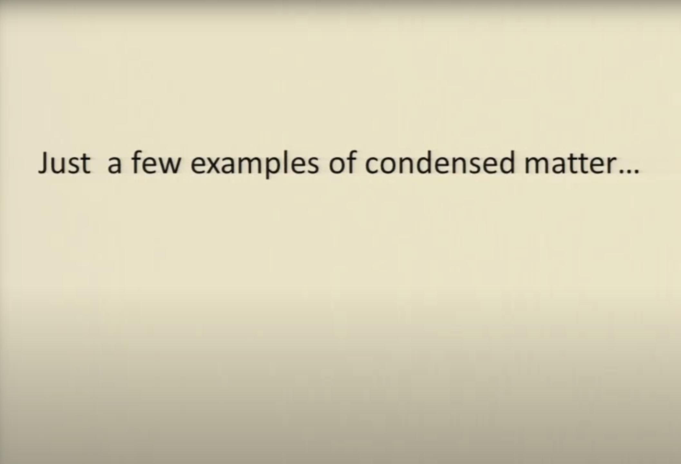
09. Geometry of Solids I: Crystal Structure in Real Space

Slide 2
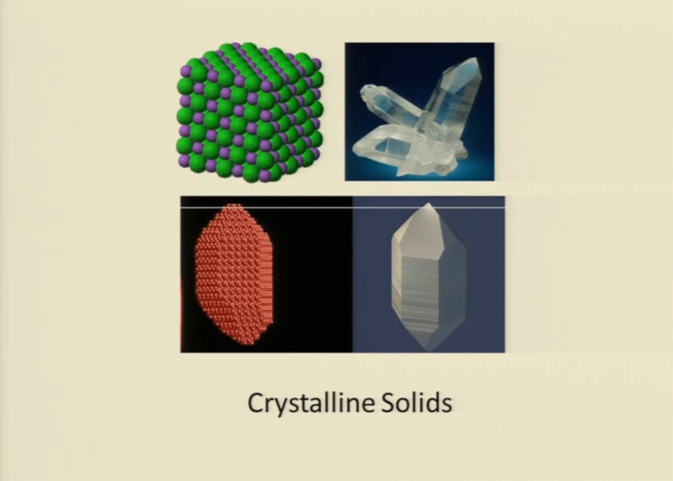

Slide 3
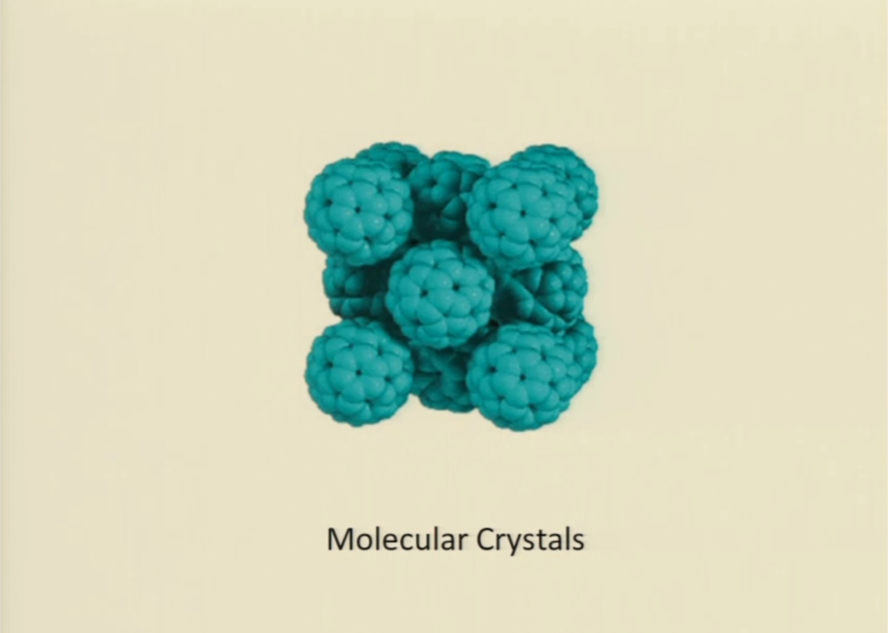

Slide 4
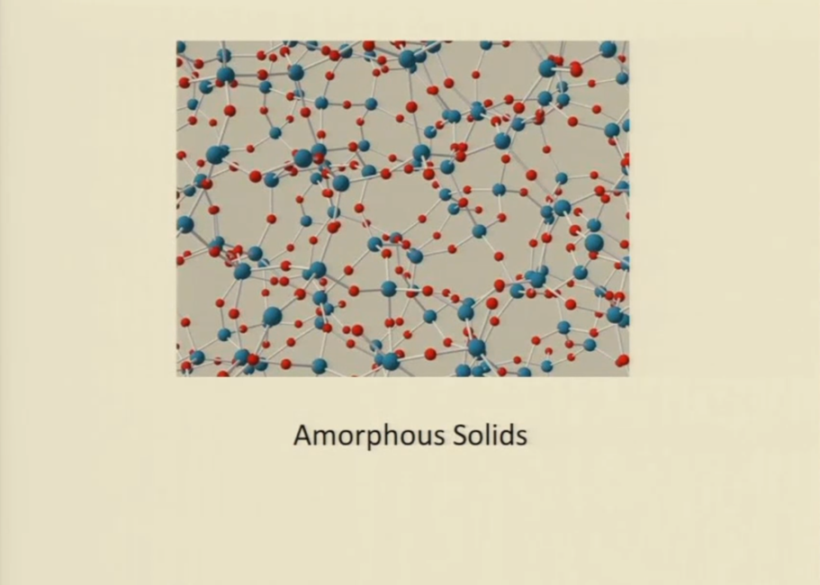

Slide 5
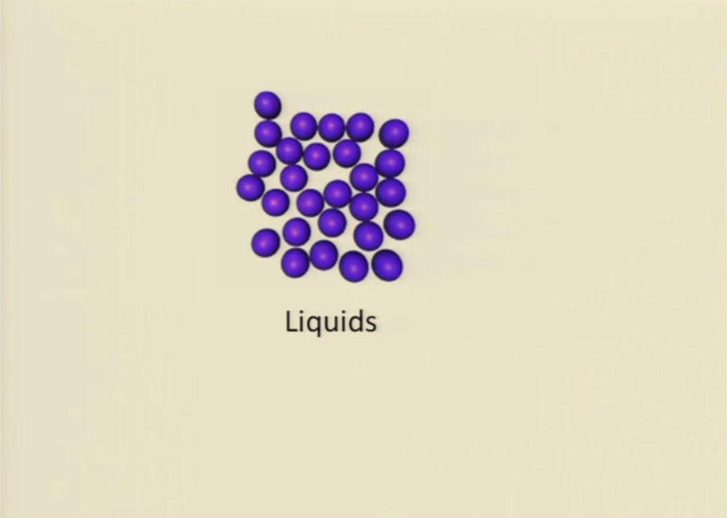

Slide 6
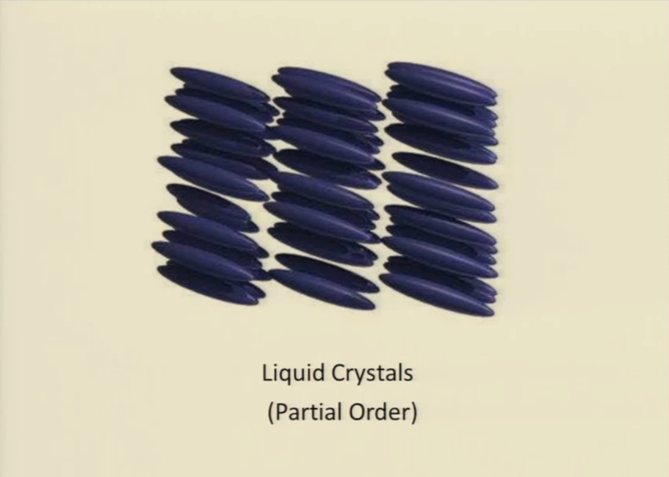

Slide 7
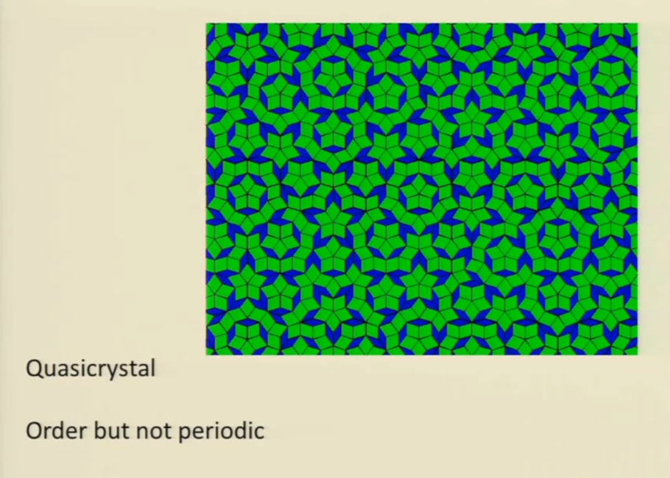

Slide 8
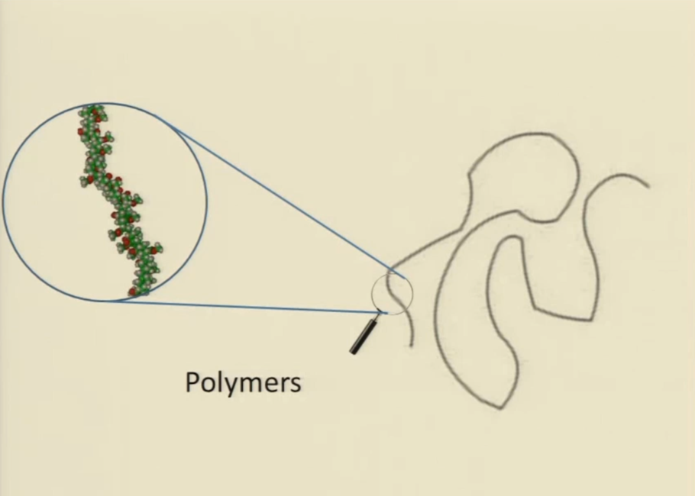

Slide 9
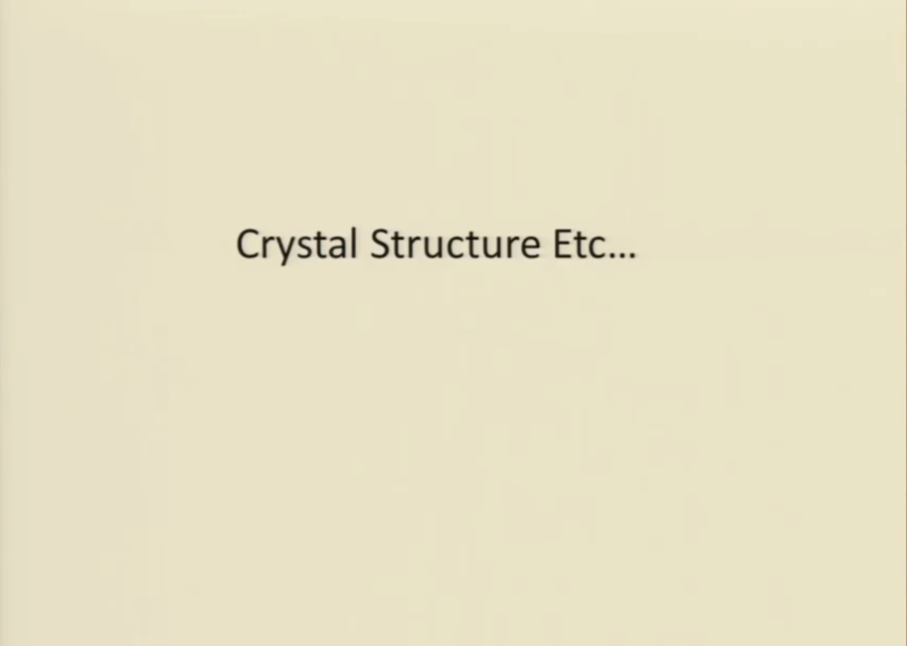

Slide 10
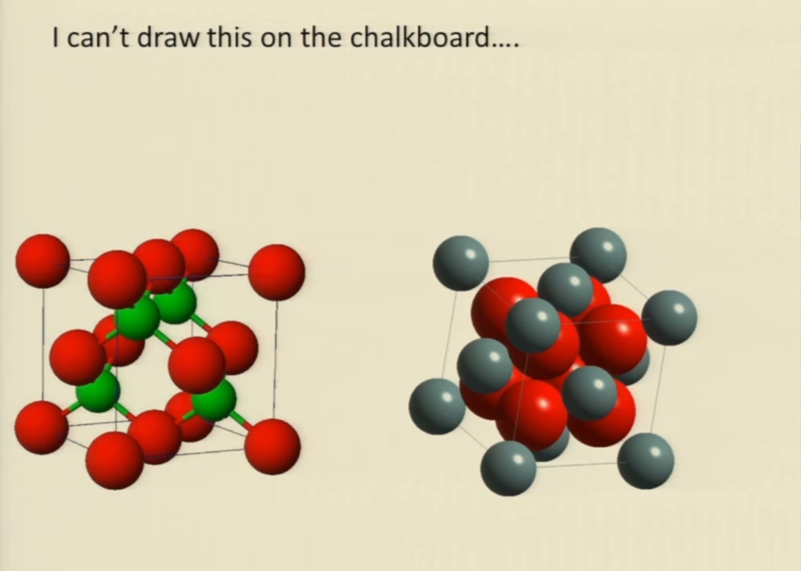

Slide 11
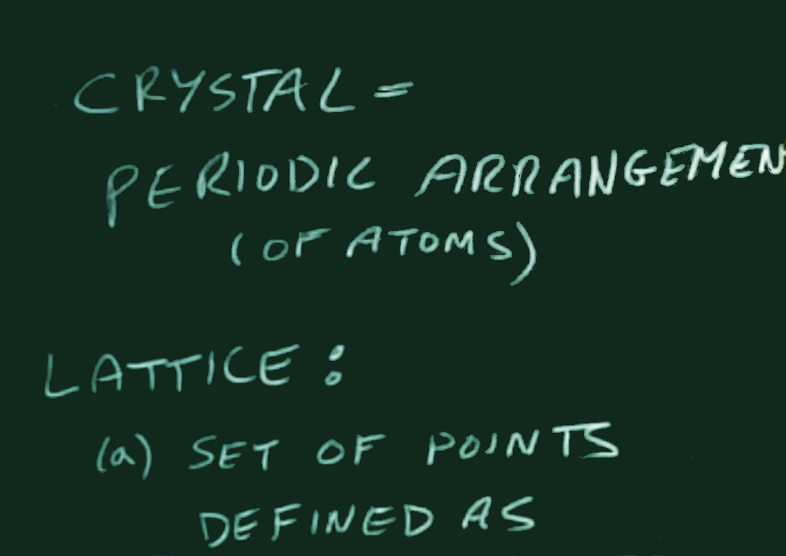

Slide 12
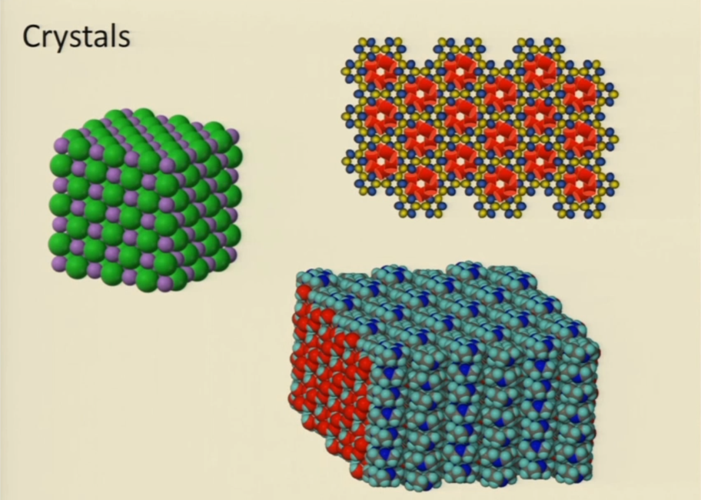

Slide 14
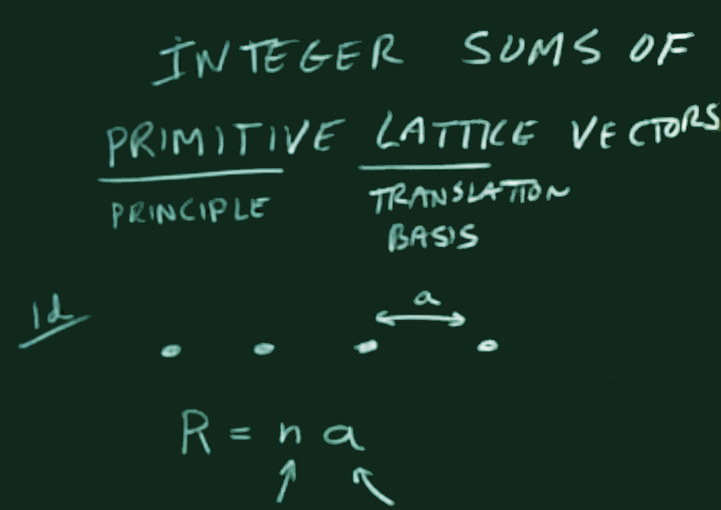

Slide 15
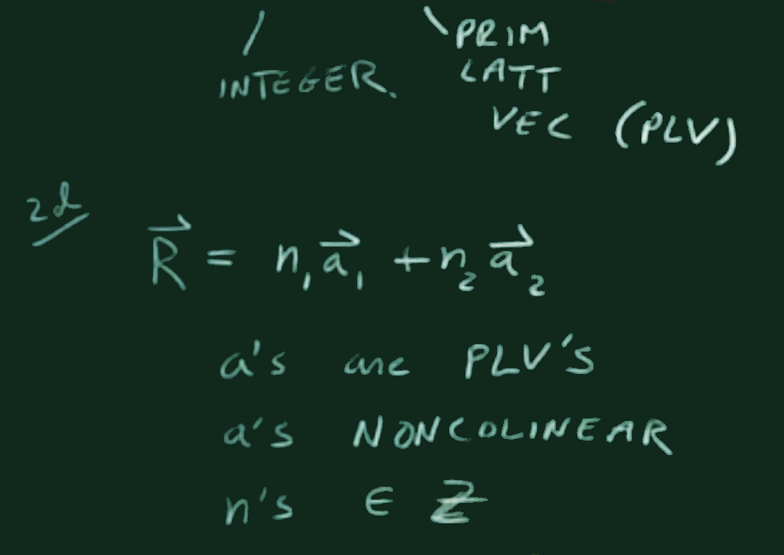

Slide 16
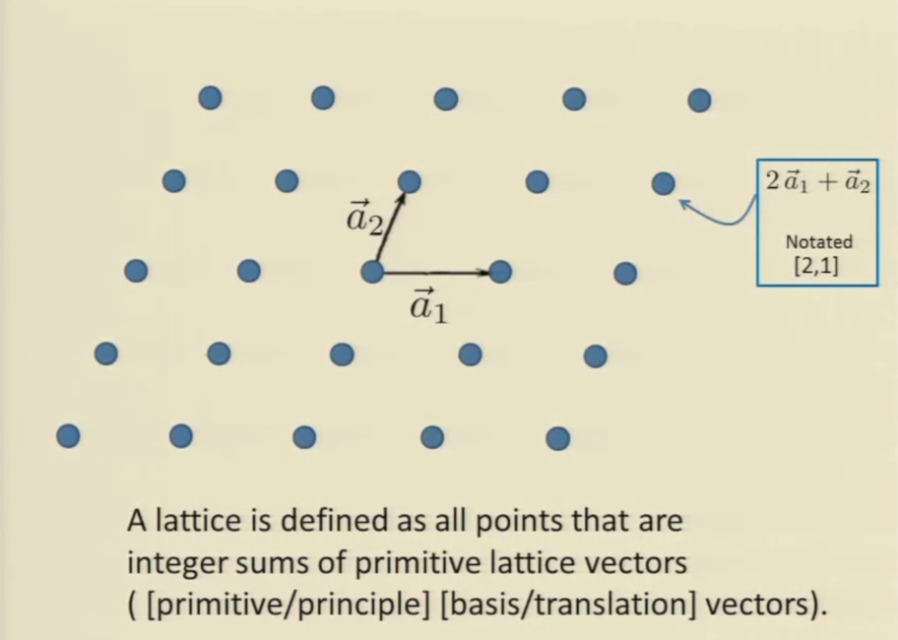

Slide 17
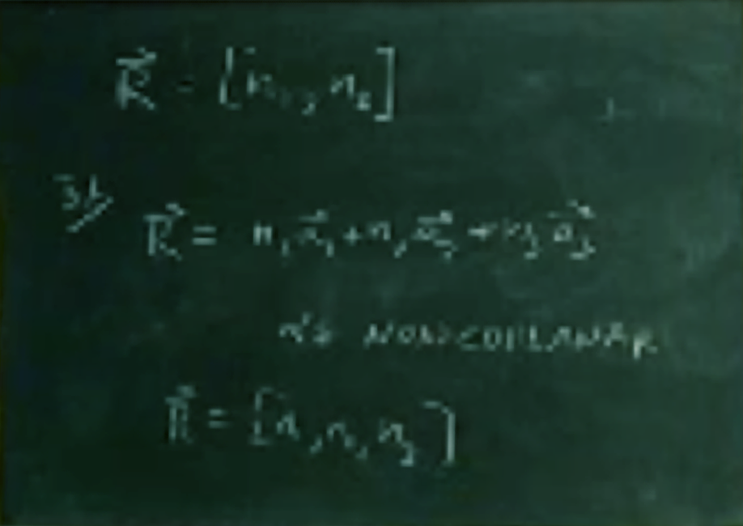




$$\overset{⃑}{R}=\left\lfloor n_{1},n_{2}\right\rfloor$$
3d
$$\overset{⃑}{R}=\left\lfloor n_{1}\overset{⃑}{a_{1}}+n_{2}\overset{⃑}{a_{2}}+n_{3}\overset{⃑}{a_{3}}\right\rfloor$$
$$n^{′}$$
s NONCOPLANAR
$$\overset{⃑}{R}=\left\lfloor n_{1},n_{2},n_{3}\right\rfloor$$

Slide 18
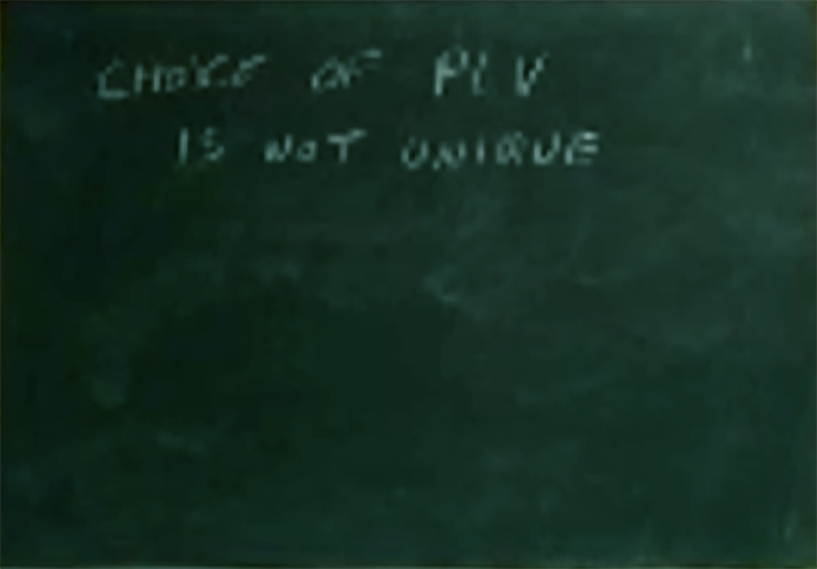
CHOICE OF PLV
IS NOT UNIQUE

Slide 19
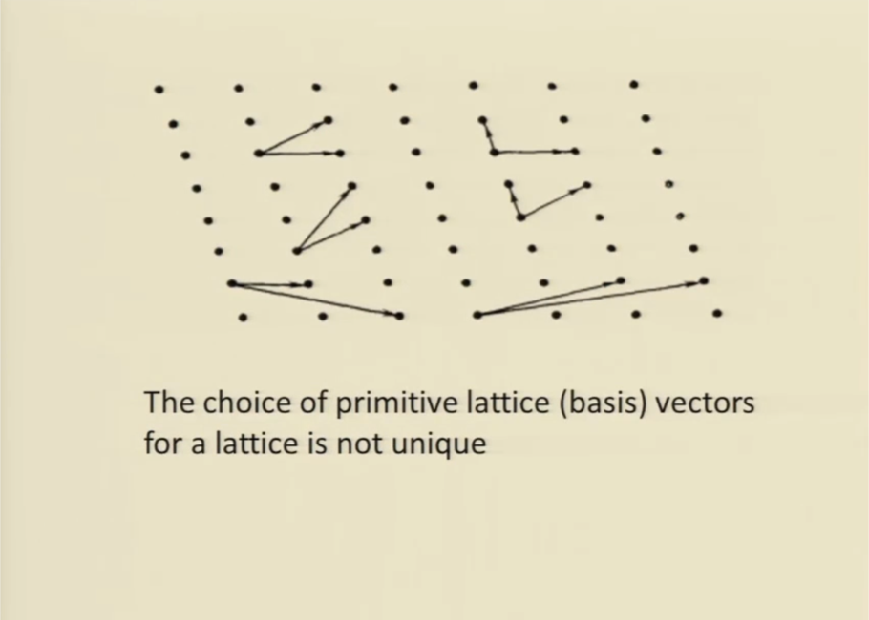

Slide 20
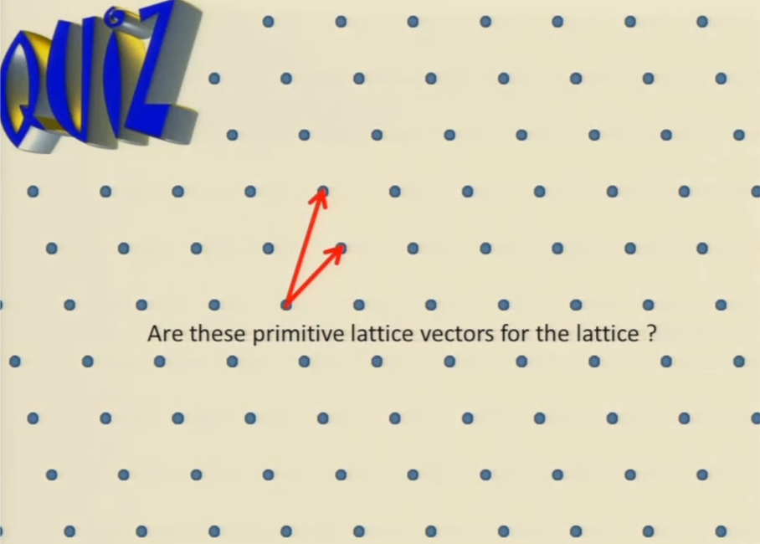

Slide 21
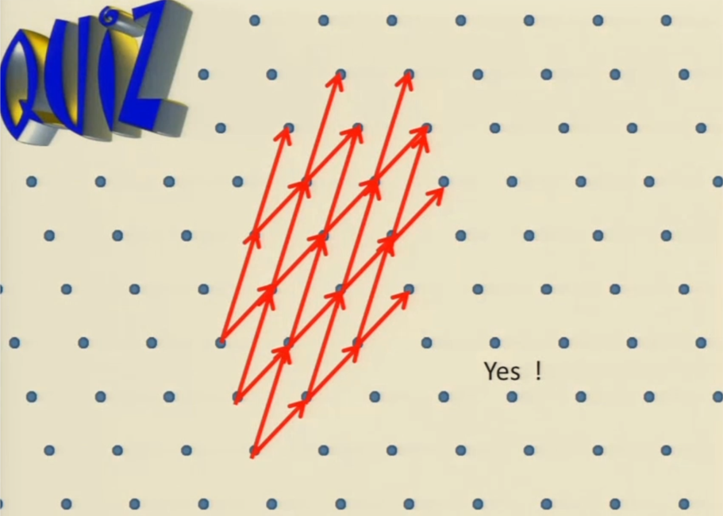

Slide 22
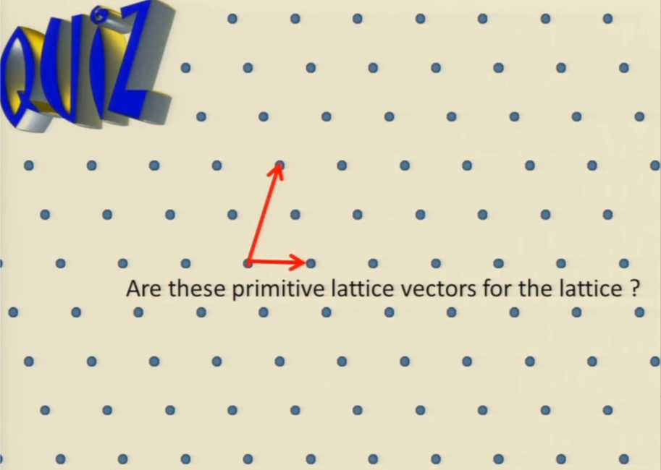

Slide 23
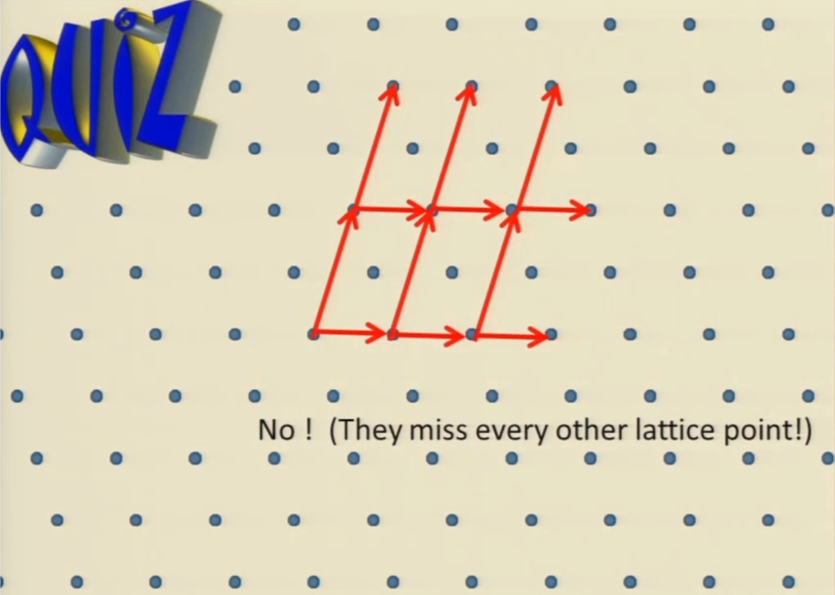

Slide 24
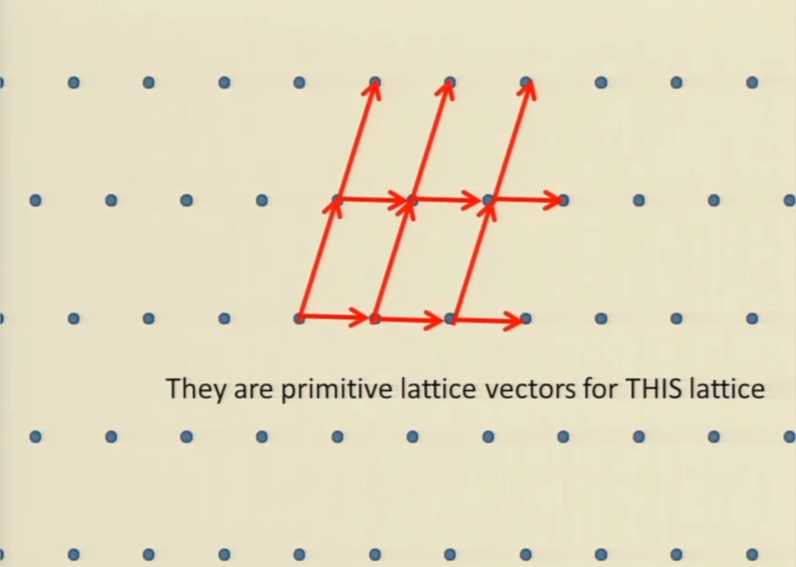

Slide 25
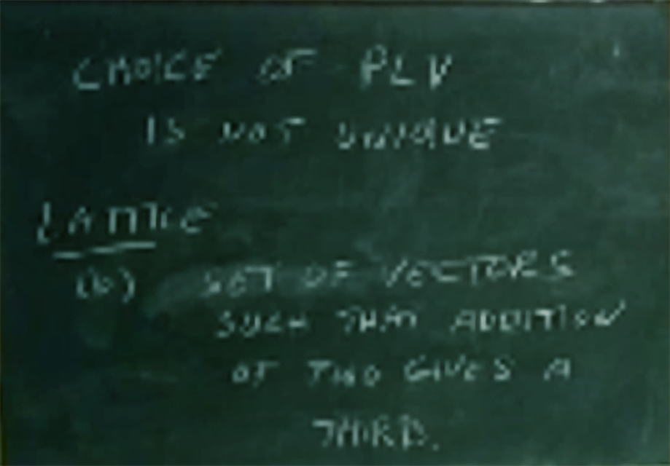
CHOICE OF PLV
IS NOT UNIQUE
LATTICE
(a)
SET OF VECTORS
SUCH THAT ADDITION
OF TWO GIVES A
THIRD.

Slide 26
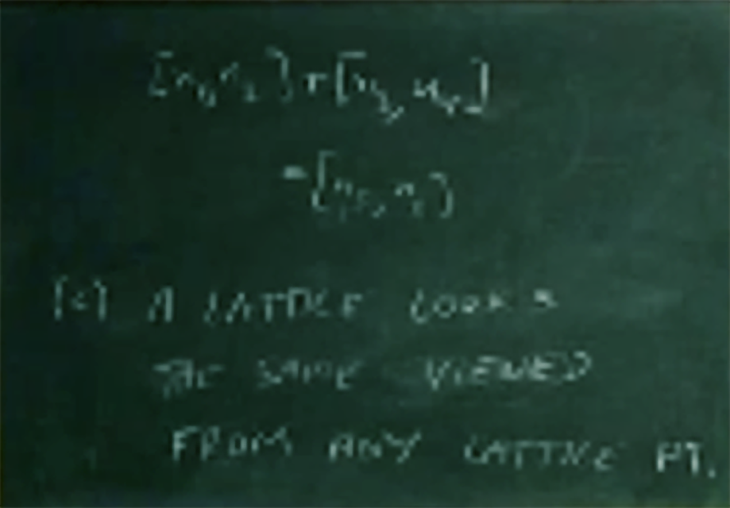


$$\left\lfloor n_{1},n_{2}\right\rfloor +\left\lfloor n_{3},n_{4}\right\rfloor$$
$$=\left\lfloor n_{5},n_{6}\right\rfloor$$
(b) A LATTICE LOOKS
THE SAME VIEWED
FROM ANY LATTICE PT.

Slide 27
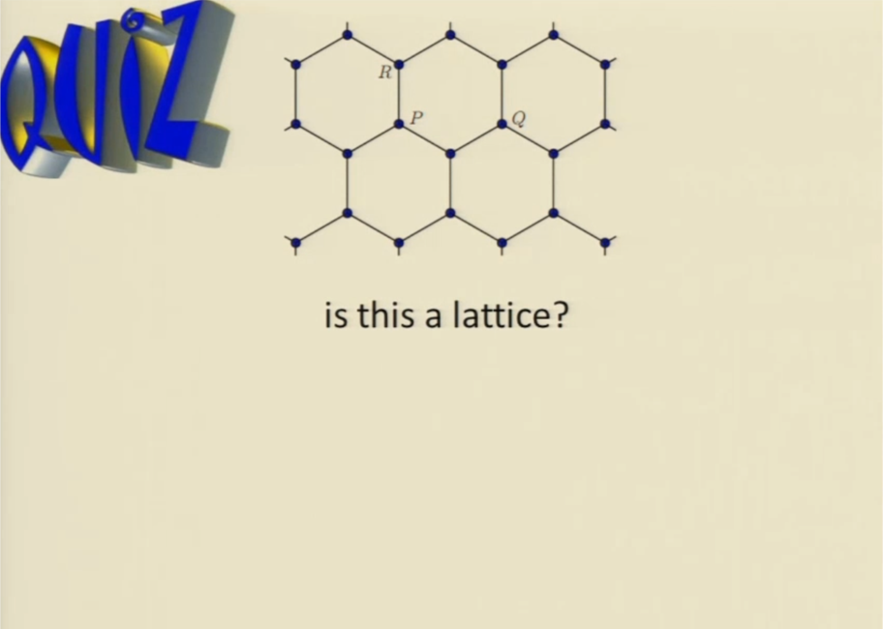

Slide 28
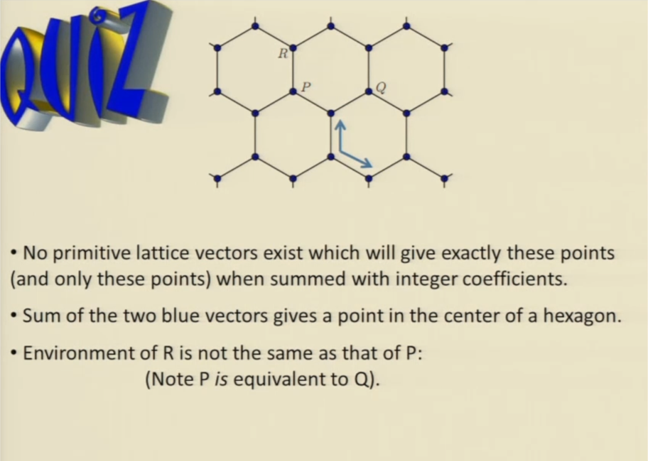

Slide 29
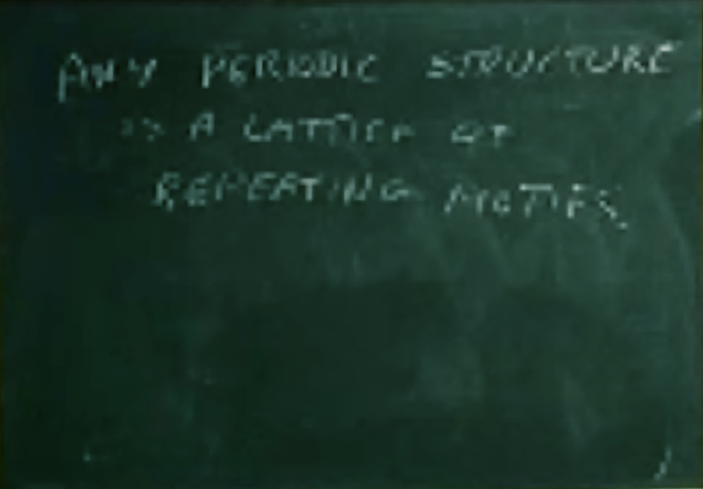
ANY PERIODIC STRUCTURE
IS A LATTICE OF
REPEATING MOTIFS.

Slide 30
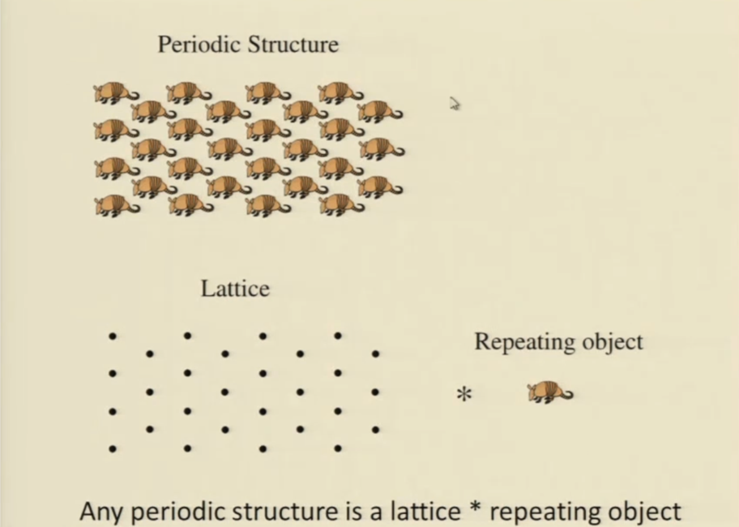

Slide 31
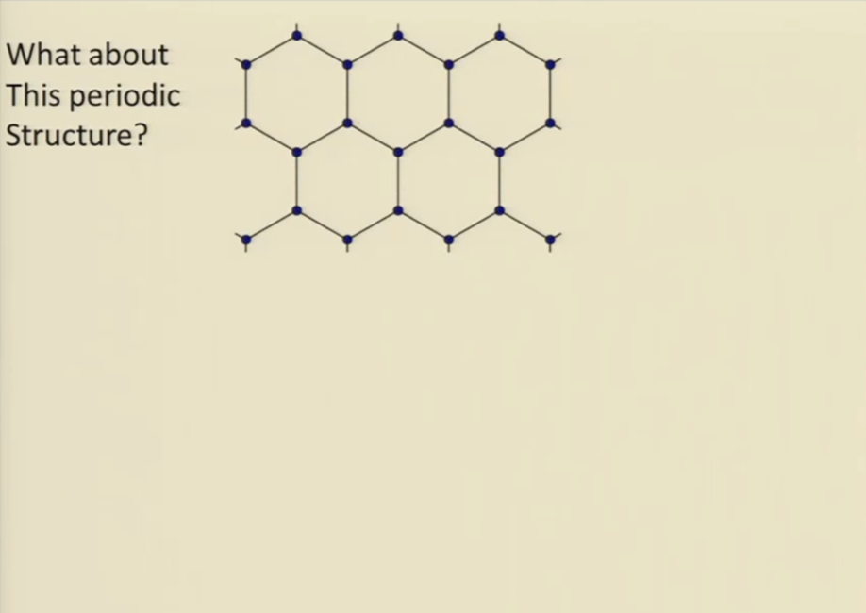

Slide 32
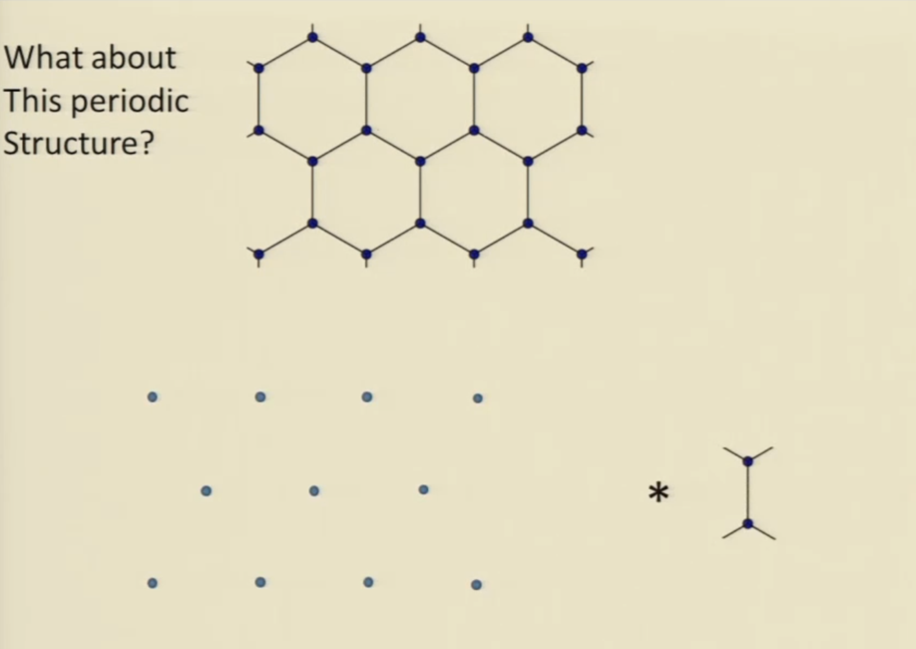

Slide 33
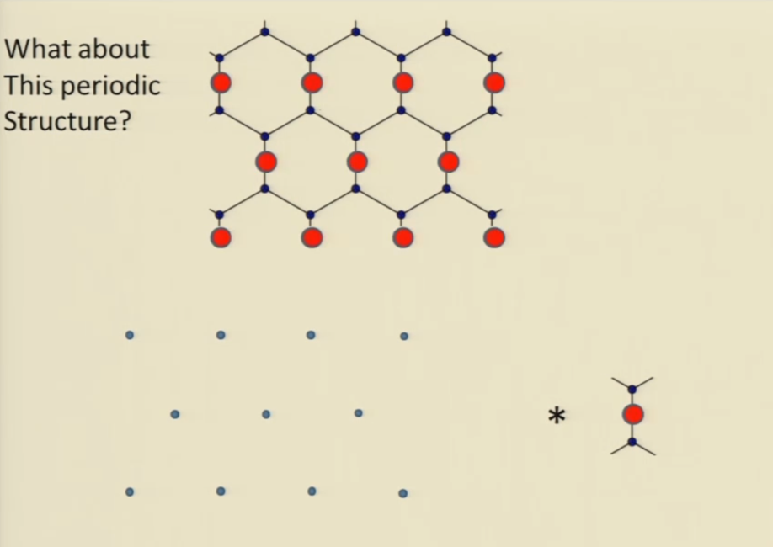

Slide 34
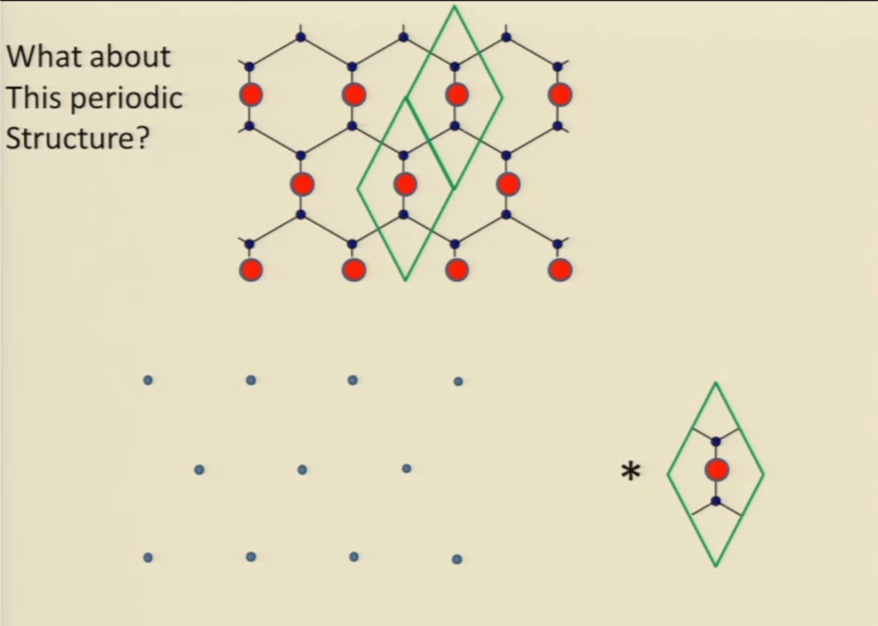

Slide 35
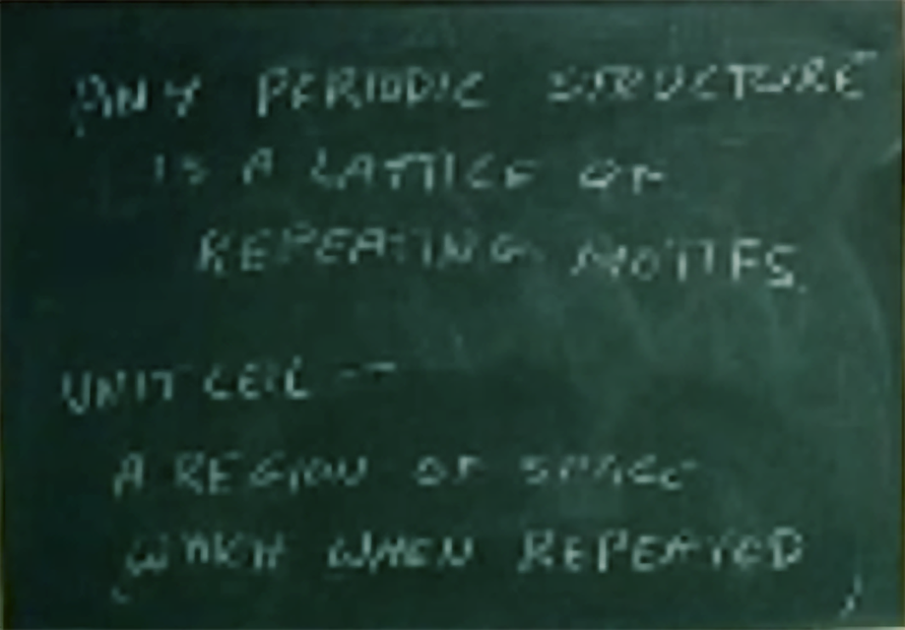
ANY PERIODIC STRUCTURE
IS A LATTICE OF
REPEATING MOTIFS.
UNIT CELL =
A REGION OF SPACE
WHICH WHEN REPEATED

Slide 36
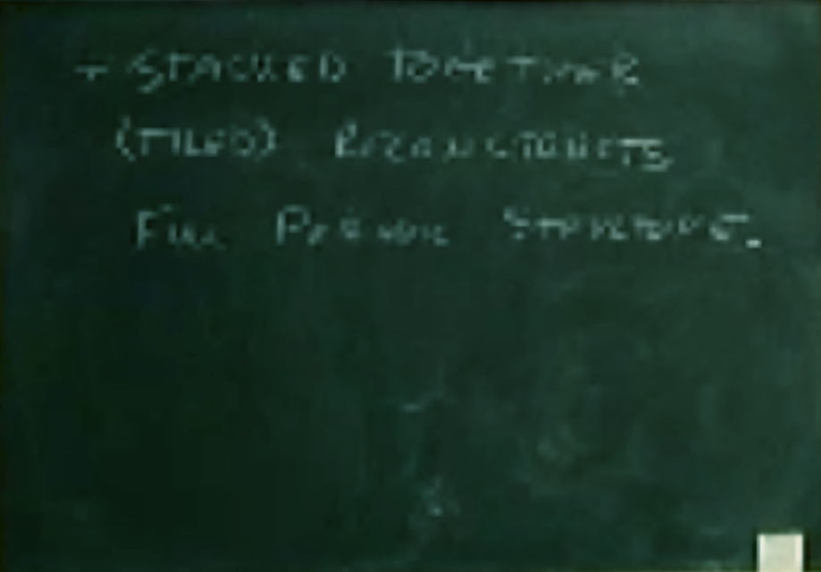
+ STACKED TOGETHER
(TILED) RECONSTRUCTS
FULL PERIODIC STRUCTURE.

Slide 37
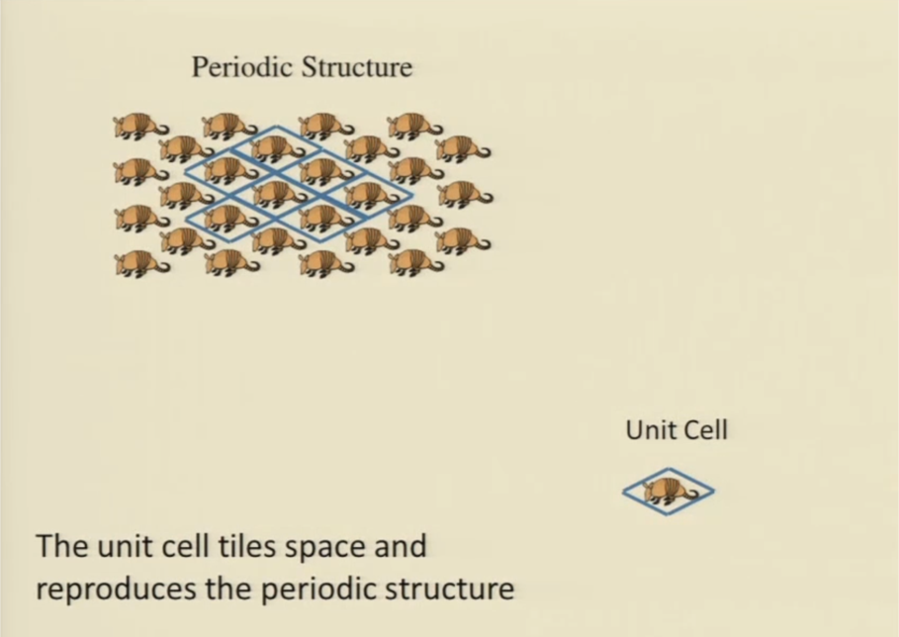

Slide 38
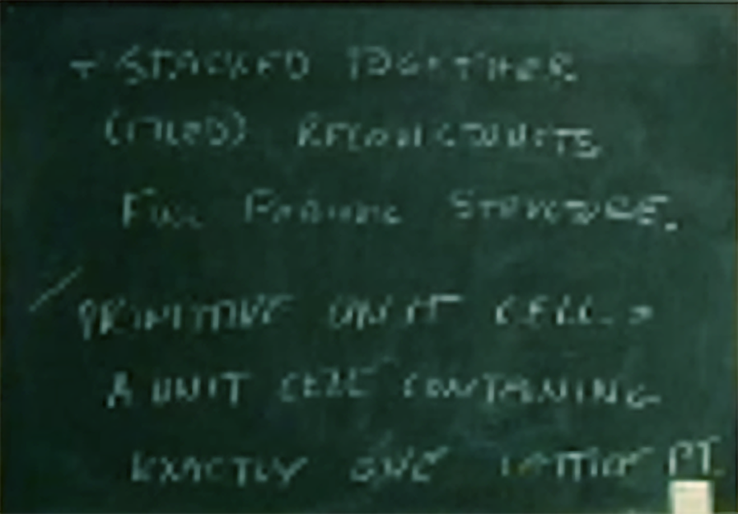
+ STACKED TOGETHER
(TILED) RECONSTRUCTS
FULL PERIODIC STRUCTURE.
PRIMITIVE UNIT CELL =
A UNIT CELL CONTAINING
EXACTLY ONE LATTICE PT.

Slide 41
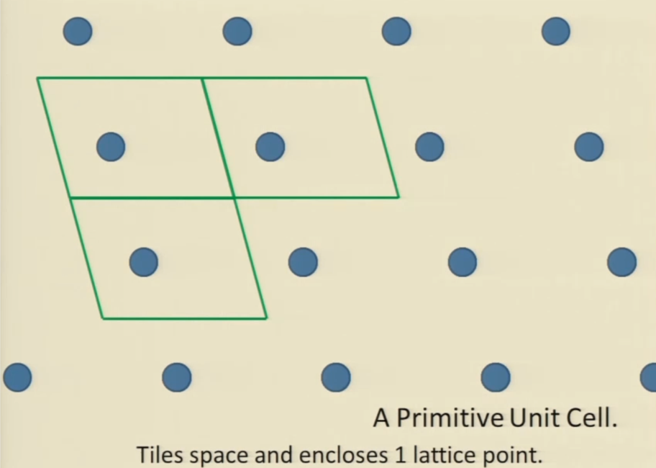

Slide 42
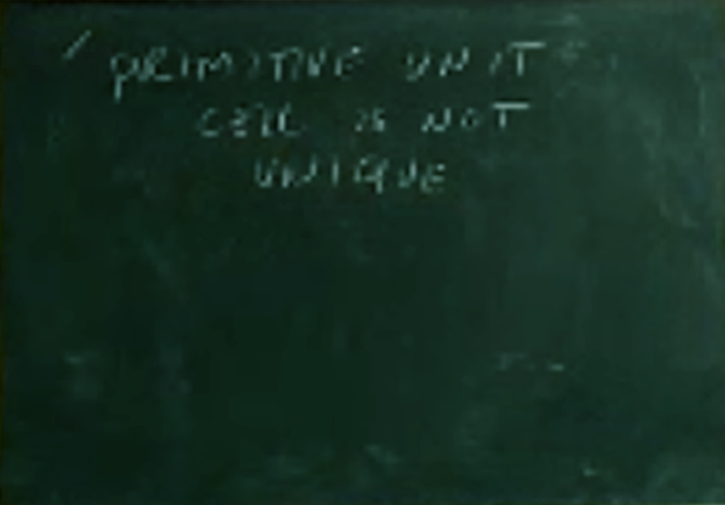
PRIMITIVE UNIT
CELL IS NOT
UNIQUE.

Slide 43
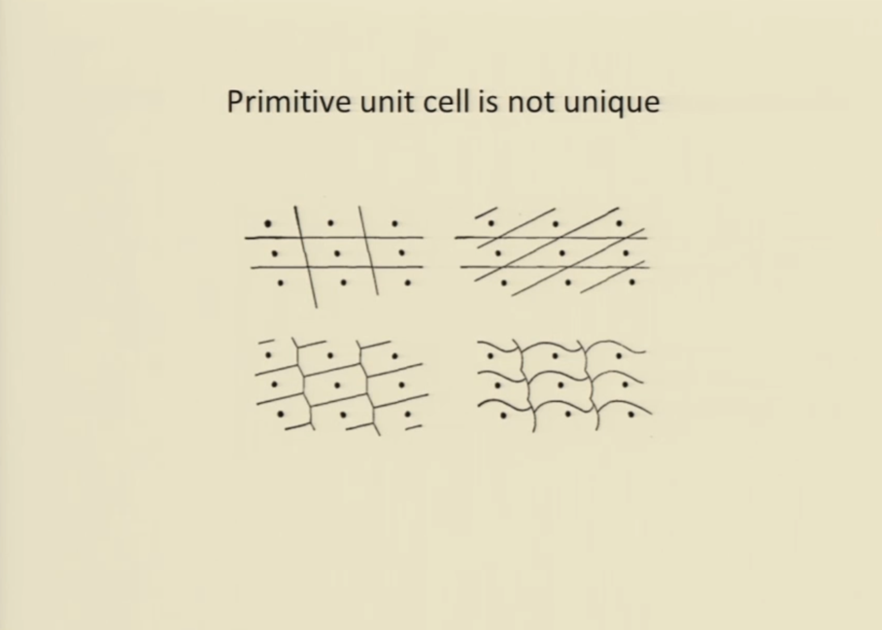

Slide 44
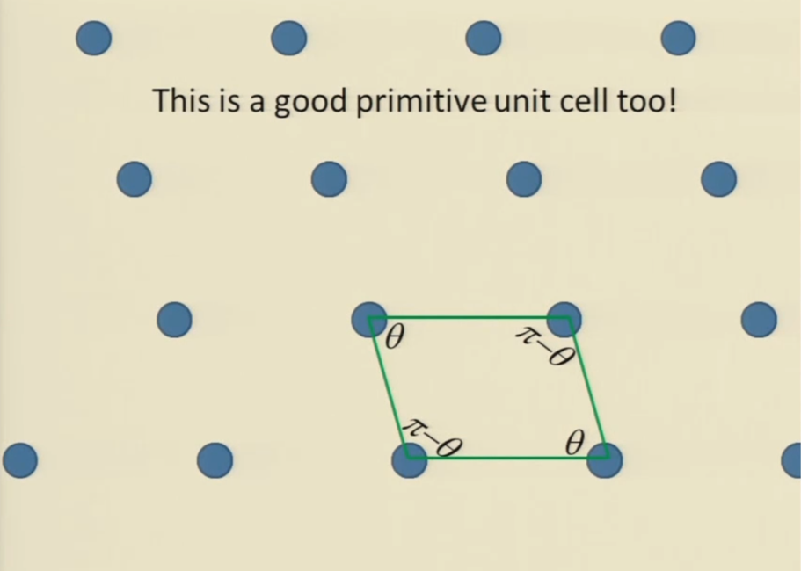

Slide 45
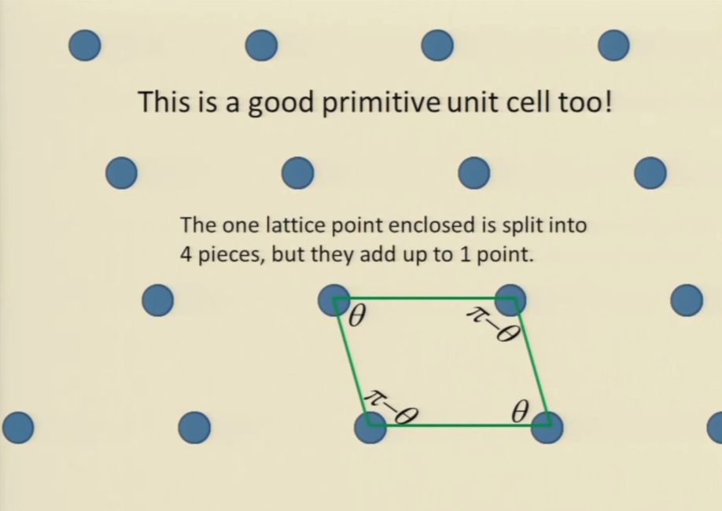

Slide 46
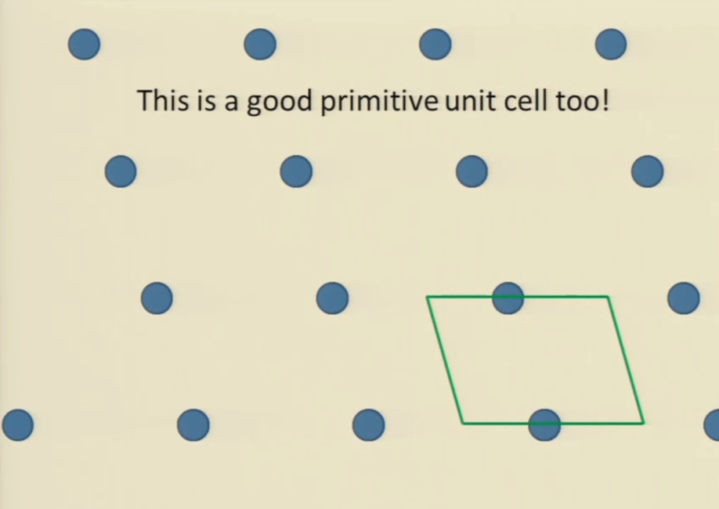

Slide 47
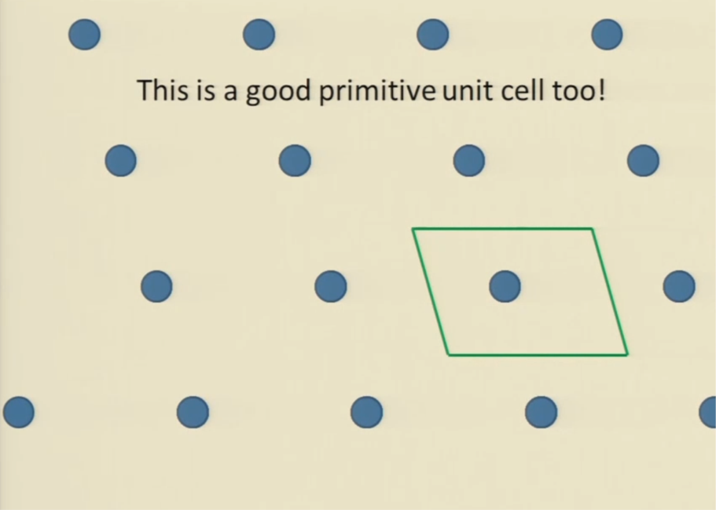

Slide 48
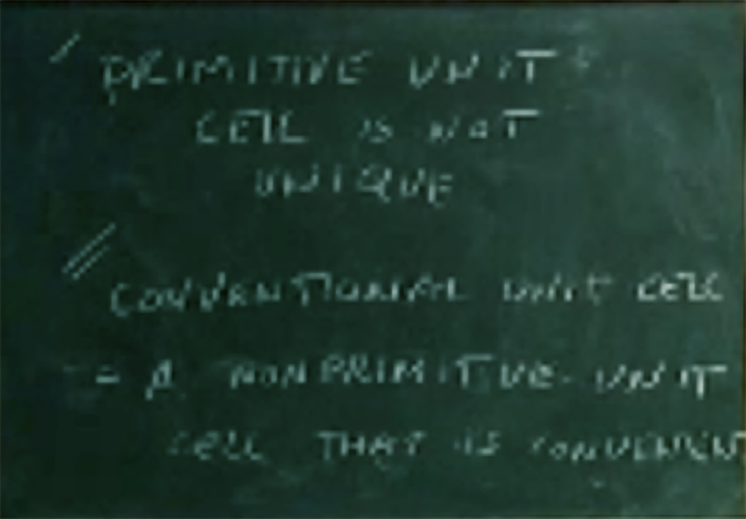
PRIMITIVE UNIT
CELL IS NOT
UNIQUE.
CONVENTIONAL UNIT CELL
= A NONPRIMITIVE UNIT
CELL THAT IS CONVENIENT

Slide 49
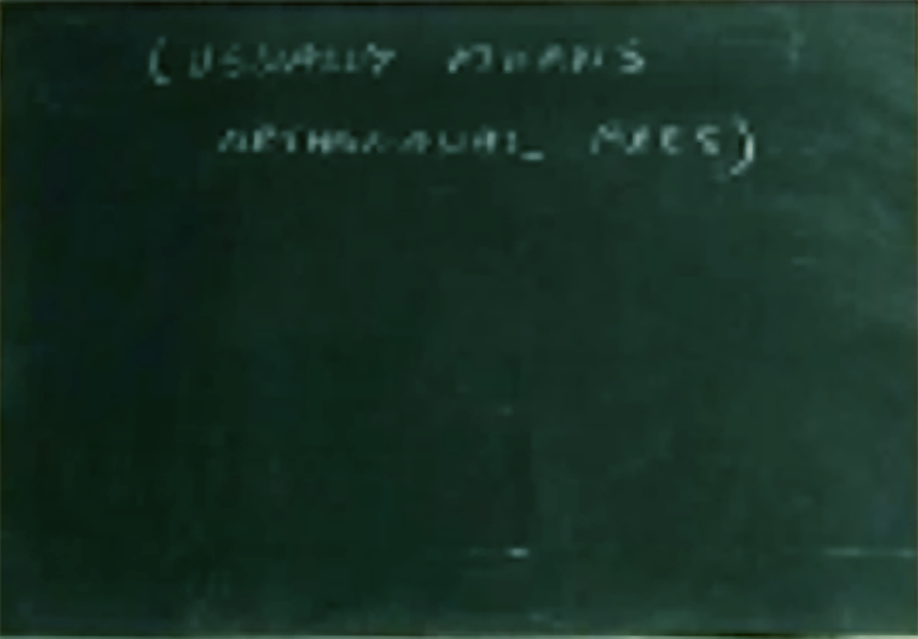
( USUALLY MEANS
ORTHOGONAL AXES)

Slide 50
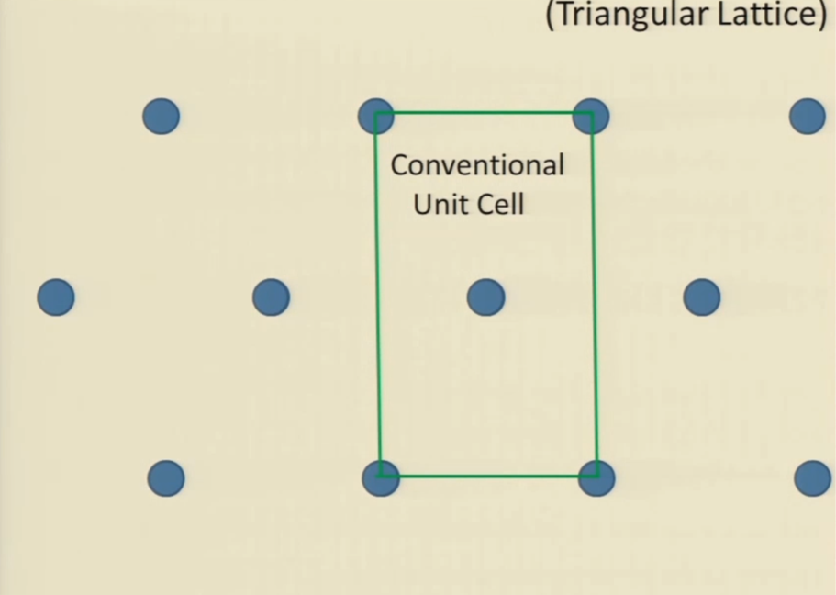

Slide 51
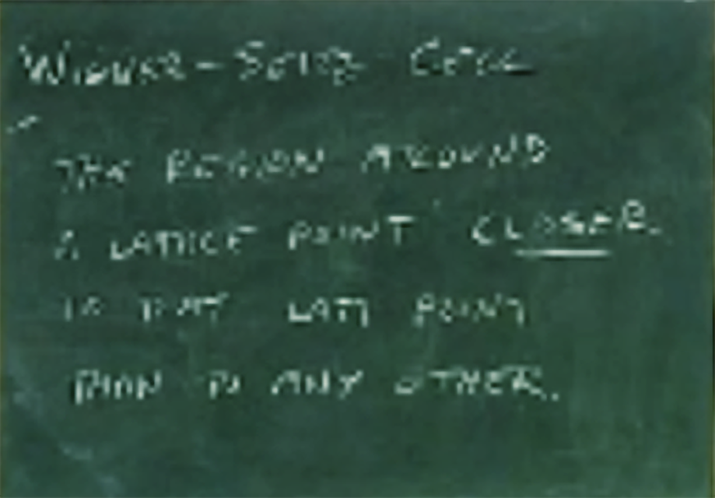
WIGNER-SEITZ CELL
THE REGION AROUND
A LATTICE POINT CLOSER
TO THAT LATT POINT
THAN TO ANY OTHER

Slide 52
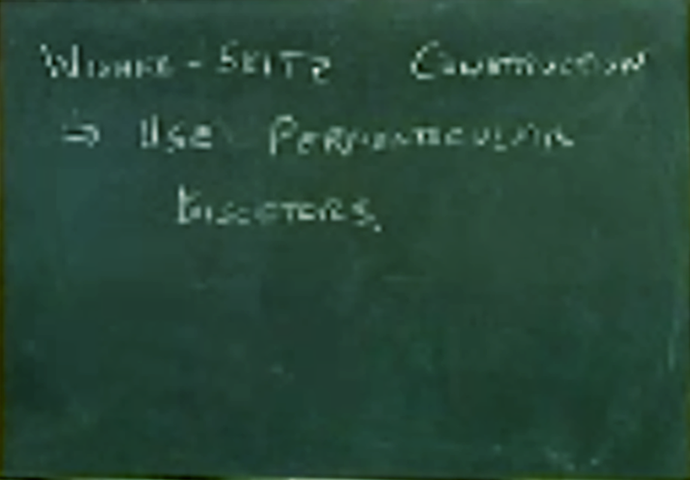
WIGNER-SEITZ CONSTRUCTION
⇒ USE PERPENDICULAR
BISECTORS.

Slide 53
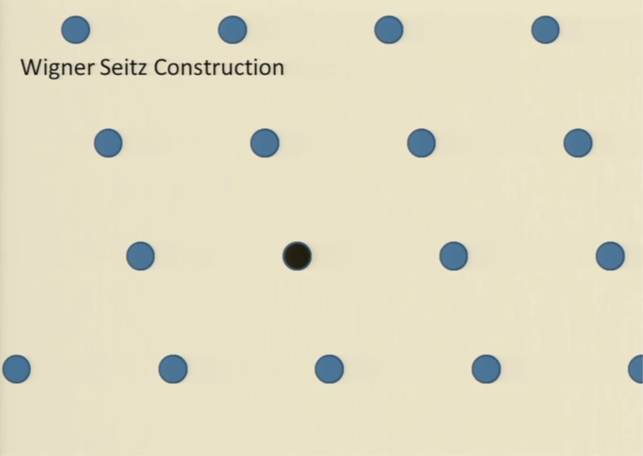

Slide 54


Slide 55


Slide 56


Slide 57


Slide 58


Slide 59


Slide 60

WIGNER-SEITZ CONSTRUCTION
⇒ USE PERPENDICULAR
BISECTORS.
W-S CELL IS PRIM UNIT
CELL.

Slide 61

VORONOI CELL
= W-S CELL FOR
A NONLATTICE
COLLECTION OF POINTS.

Slide 62


Slide 63

BASIS:
DESCRIPTION
OF OBJECT IN UNIT
CELL WITH RESPECT
TO A REFERENCE
LATTICE POINT.

Slide 64


Slide 65


Slide 66


Slide 67

3D LATTICES
* YOU WILL NOT
NEED TO KNOW
ABOUT LATTICES IN 3D
WHERE AXES ARE
NOT ORTHOGONAL *

Slide 68

CUBIC LATTICE
SIMPLE CUBIC
PRIMITIVE CUBIC
CUBIC P
UNIT CELL = CUBE

Slide 69

IS THERE ANY?

Slide 70






https://en.wikipedia.org/wiki/Integer
$$\overset{⃑}{R}=\left\lfloor u, v, w\right\rfloor ×a$$
$$u, v,w ∈ℤ$$
$$\overset{⃑}{a_{1}}=a\left\lfloor 1, 0, 0\right\rfloor$$
$$\overset{⃑}{a_{2}}=a\left\lfloor 0, 1, 0\right\rfloor$$
PLV’S
$$\overset{⃑}{a_{3}}=a\left\lfloor 0, 0, 1\right\rfloor$$

Slide 71

COORDINATION NUMBER
= Z
= # OF NEAREST
NEIGHBOURS

Slide 72

TETRAGONAL LATTICE
AXES ⊥ 2 EDGES EQUAL
ORTHORHOMBIC
AXES ⊥ NO EDGES EQUAL

Slide 73


Slide 76



CsCl STRUCTURE
P. CUBIC LATTICE W/ BASIS
Cs @
$$\left\lfloor 0, 0, 0\right\rfloor$$
Cl @
$$\left\lfloor 1/2,1/2,1/2\right\rfloor$$

Slide 77


Slide 78


Slide 79



PURE Cs
(CUBIC P LATTICE)
Cs @
$$\left\lfloor 0, 0, 0\right\rfloor$$
Cs @
$$\left\lfloor 1/2,1/2,1/2\right\rfloor$$

Slide 80


Slide 81

BODY CENTERED CUBIC
LATTICE
CUBIC - I

Slide 82

COORDINATION NUMBER?

Slide 83


Slide 84


